Slide 1
Standards and tools for publishing biodiversity data
Yu-Huang Wang
June 25, 2012

Slide 2
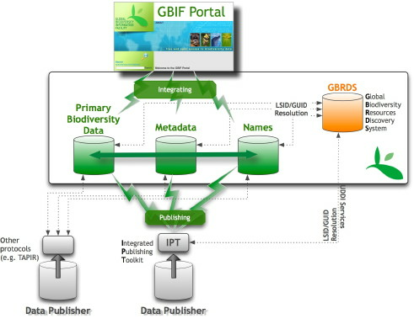
GBIF informatics infrastructure

Slide 3
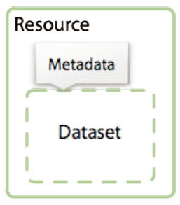
GBIF biodiversity data resources
Resource = Meta data + Dataset
A dataset is a collection of data records.
Metadata describe datasets. In context of GBIF, metadata provide information about the suppliers of biodiversity data and about the origins and purpose of those data.

Slide 4
GBIF biodiversity data resources
A data record is a collection of record elements or properties. An example data record may describe a museum specimen. One of the data elements would almost certainly be a scientific name element.
A record element contains the data values (i.e., the data). An example value in a scientific name record element would be Abies kawakamii.

Slide 5
Three core data types
Primary biodiversity data or occurrence data, e.g., a dataset of bird observation data records, specimen data records from a natural history museum, etc.
Taxonomic data, e.g., a dataset of an annotated checklist of bird species
Resource metadata, data records that provide descriptive information about datasets.
Notes:
Metadata are important to improve dataset discovery and to provide potential users with details on the ‘fitness-for-use’ of the data they describe. Metadata can describe both digital and non-digital data sets: data publishers can also publish metadata about datasets that are yet ready to be published.

Slide 6
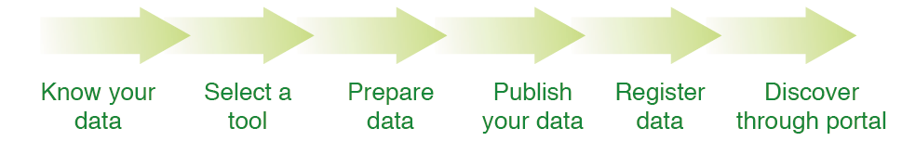
Data publishing workflow

Slide 7
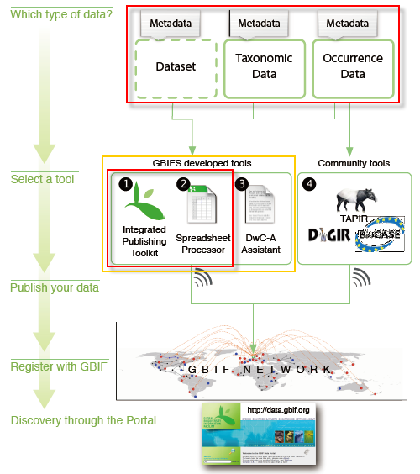
Publishing options in the GBIF Network

Slide 8
Standards for publishing data
Darwin Core - occurrence - check list
EML metadata
Darwin Core Archive

Slide 9
Darwin core terms
Record-level
Occurrence
Event
GeologicalContext
Location
Identification
Taxon
ResourceRelationship
MeasurementOrFact
Type Vocabulary
http://code.google.com/p/darwincore/

Slide 10
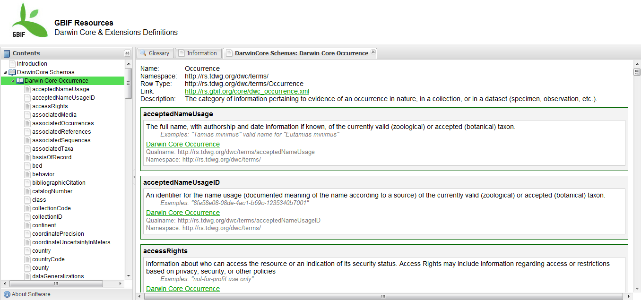
Darwin core & extensions definitions
http://tools.gbif.org/resource-browser/

Slide 11
EML
GBIF metadata profile is primarily based on the Ecological Metadata Language (EML).
Currently, GBIF refers to KNB EML 2.1.0 specification (http://knb.ecoinformatics.org/software/eml/)
GBIF profile utilizes a subset of EML and extends it to include additional requirements that are not accommodated in the EML specification.

Slide 12
12 forms for metadata in IPT2
Basic Metadata
Geographic Coverage
Taxonomic Coverage
Temporal Coverage
Other Keywords
Associated Parties
Project Data
Sampling Methods
Citations
Collection Data
Physical Data
Additional Metadata

Slide 13
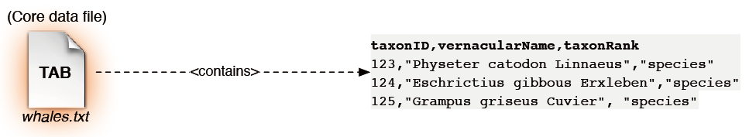
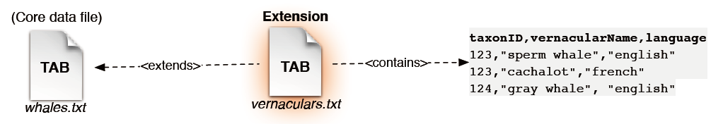
Darwin core archive (DwC-A) component
Core data file
Optional extension file
scientificName

Slide 14
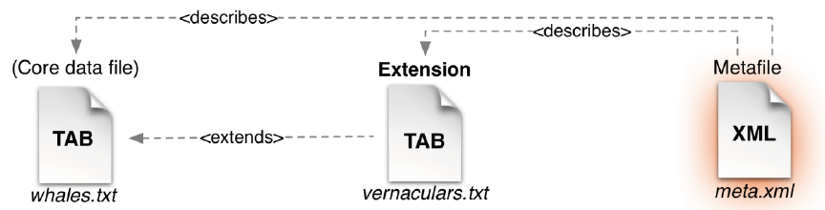
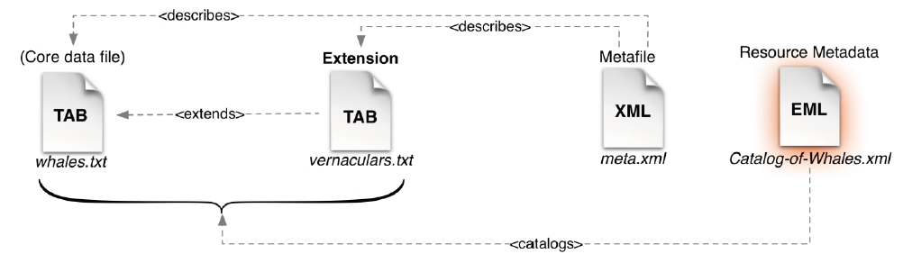
Darwin core archive (DwC-A) component
Metafile
Resource metadata

Slide 15
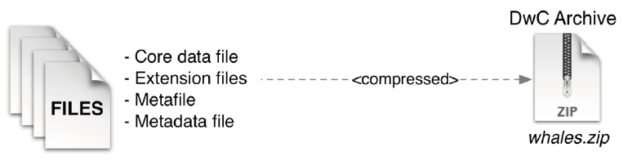
Darwin core archive (DwC-A)
Core data file
Extension files
Metafile
Metadata file

Slide 16
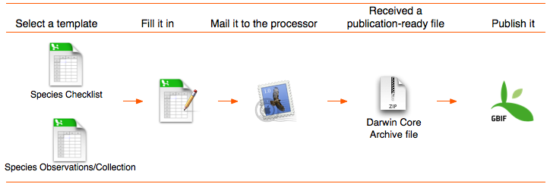
Tools
Excel templates
Spreadsheet processor
IPT2

Slide 17
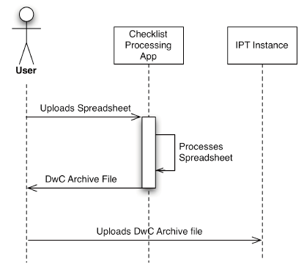
Data publishing mechanism

Slide 18
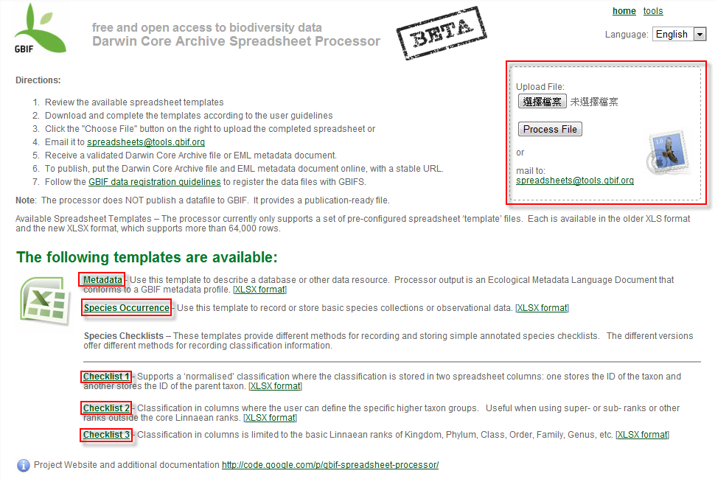
Excel template & spreadsheet processor
http://tools.gbif.org/spreadsheet-processor/

Slide 19
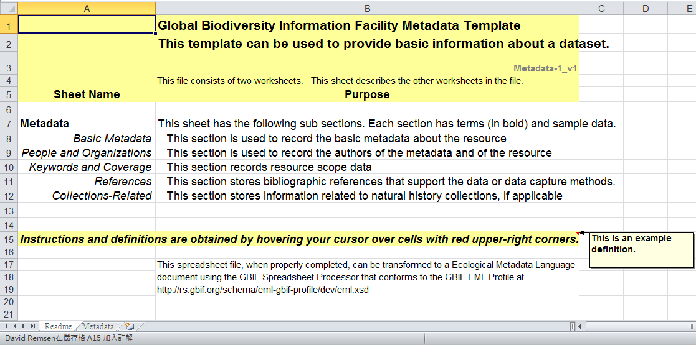
Metadata template
Readme

Slide 20
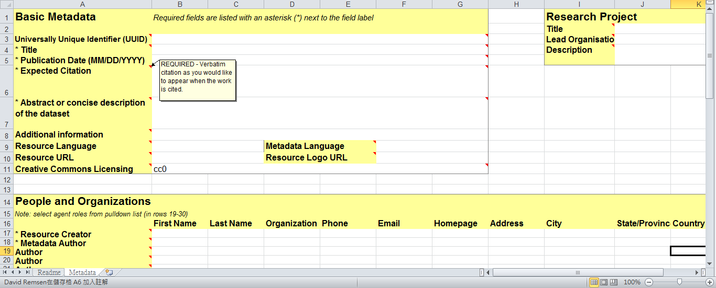
Metadata template
Metadata

Slide 21
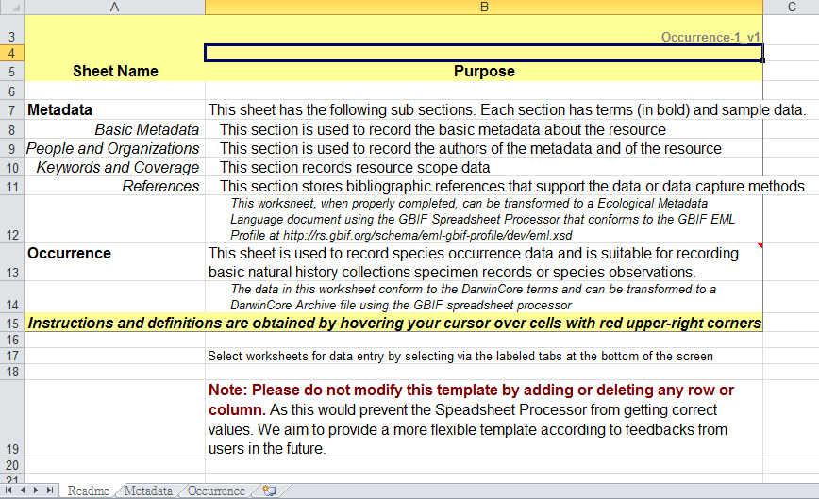
Occurrence template
Readme

Slide 22
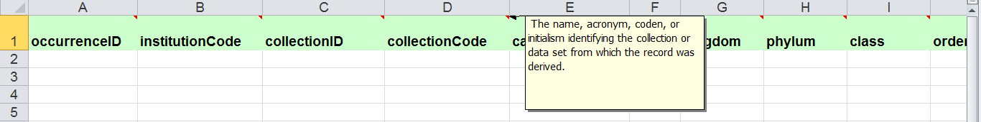
Occurrence template
Metadata
Occurrence - 45 terms (columns)

Slide 23
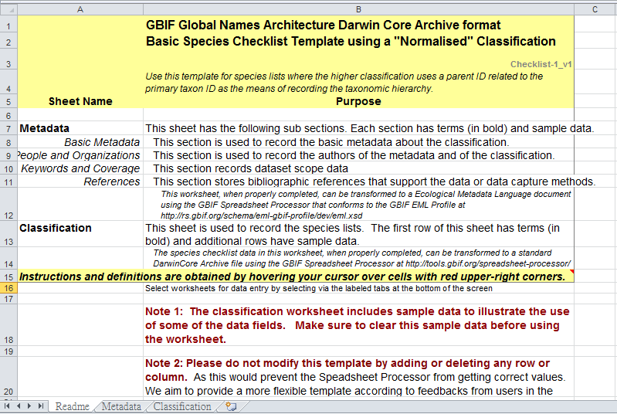
Check list 1 template
Readme

Slide 24
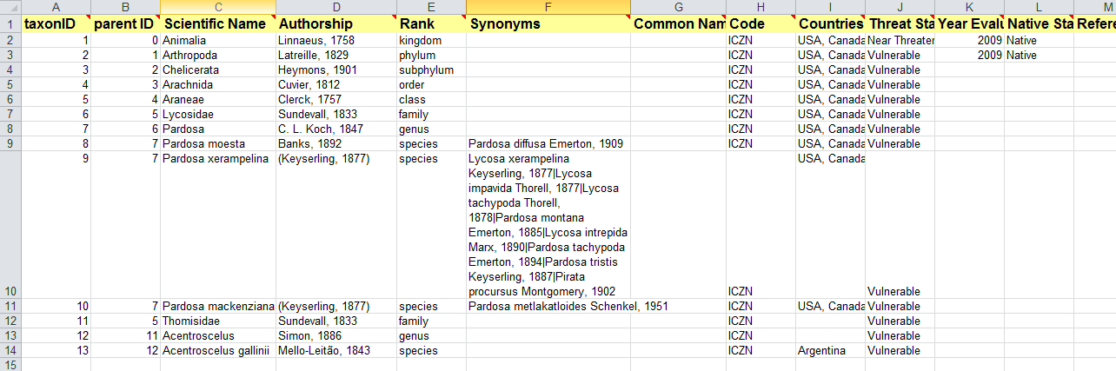
Check list 1 template
Classification “Nomalized” - 14 terms (columns)

Slide 25
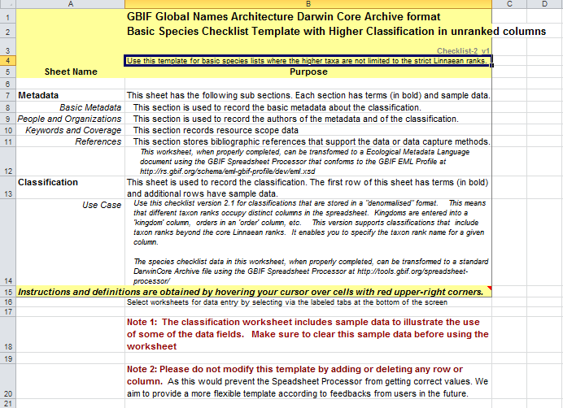
Check list 2 template
Readme

Slide 26
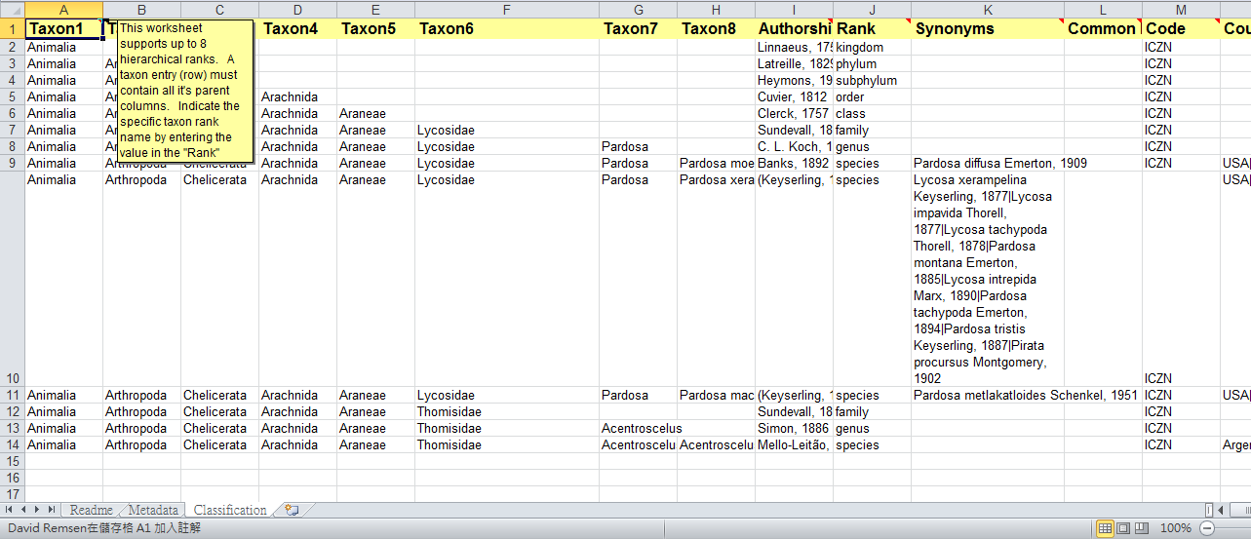
Check list 2 template
Higher Classification in unranked columns - 19 terms (columns)

Slide 27
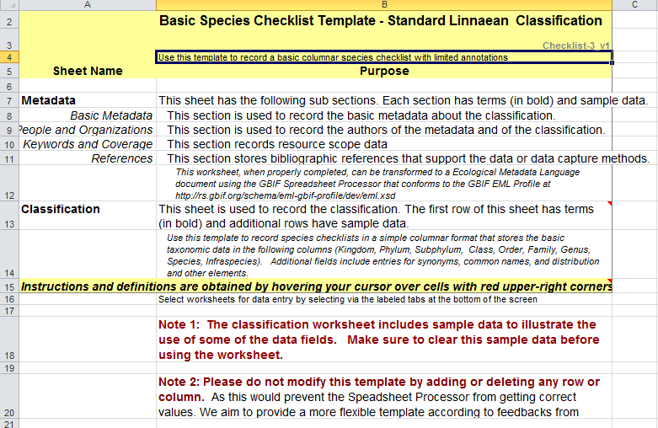
Check list 3 template
Readme

Slide 28
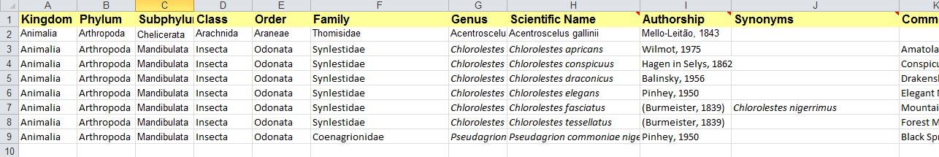
Check list 3 template
Standard Linnaean Classification - 18 terms (columns)

Slide 29
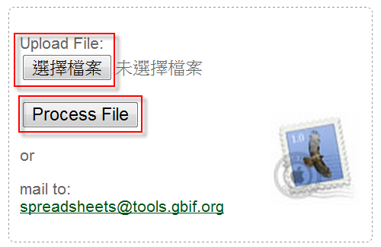
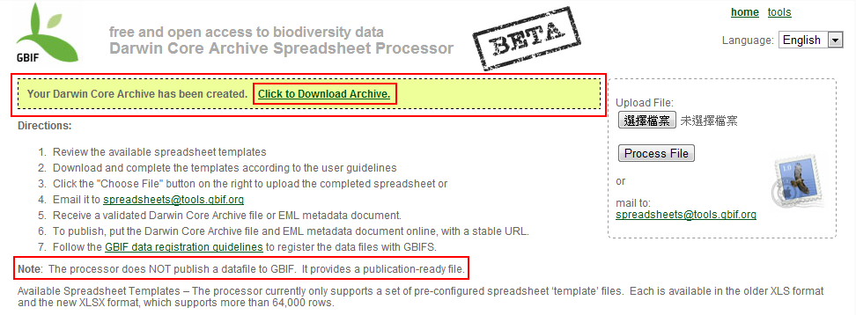
Upload your excel template

Slide 30
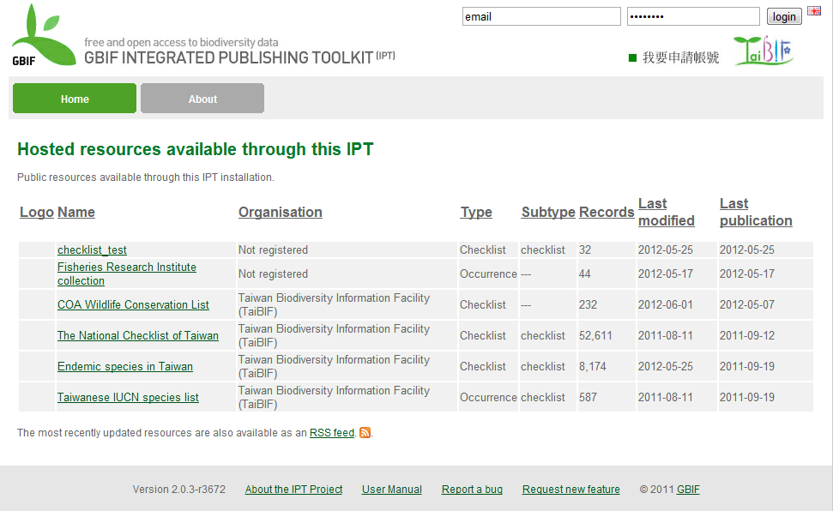
Publish data via IPT2

Slide 31
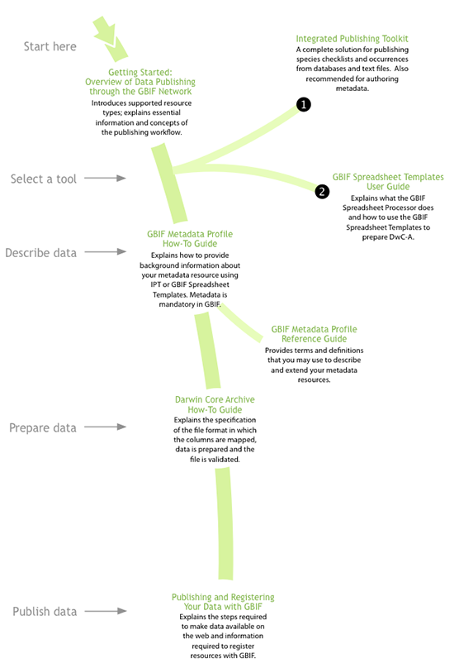
Document map for publishing data
http://www.gbif.org/informatics/discoverymetadata/publishing/

Slide 32
Thank You!
http://taibif.tw

